Slide 1







AI-Driven, Context-Specific Prioritization of Health Products in Trans Nzoia County Using the SMArT Tool
Presenter & Co-Authors: Govanna Star, Mark Osiemo, Obadia Yano, Dr. Pius Ndunde (MOH) , Dr. David Wesaya (MOH)
Institutional Affiliations: inSupply Health & Ministry of Health Kenya
Technological advancements in public health
Kenya Health Security Convention | 5th – 8th May 2026 | Mombasa - Kenya

Slide 2



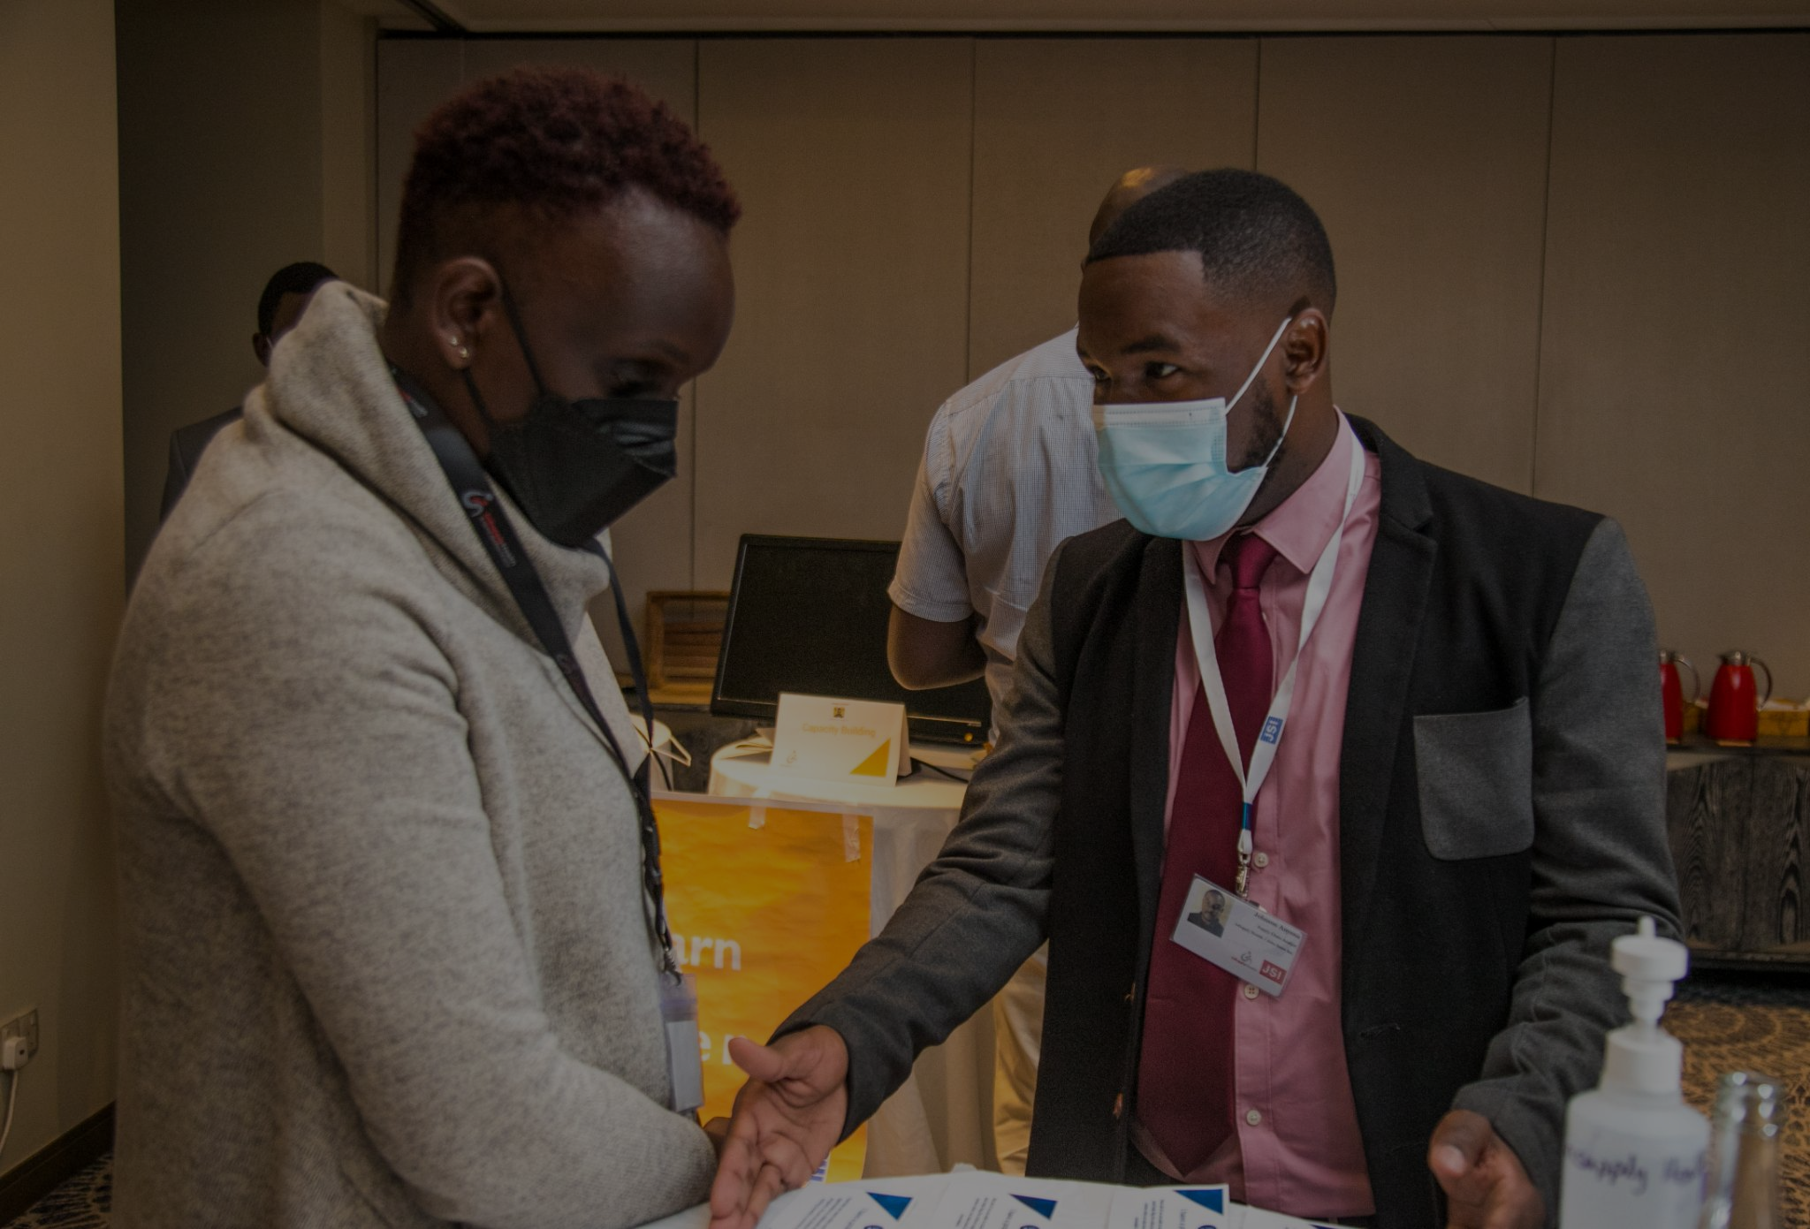
Overview of inSupply Health
Who We Are:
inSupply Health, an East African health advisory firm, pioneers innovative approaches for improving health access and outcomes through strengthening health systems and supply chains.
Domain Expertise
Market Access
&
Shaping
Supply Chain Transformation
Data Transformation Intelligence & Impact
Established in-country offices
Workforce Optimization
Upcoming establishment of in-country offices
Providing technical assistance

Slide 3
Background & Introduction
Across Kenya's public health facilities, commodity ordering is manual, non-standardized,
and not evidence-based thus causing critical medicines to run out while non-priority
products accumulate.
❌
⚠️
📉
Manual & Error-Prone
Budget Misalignment
No Transparency
Procurement decisions rely on individual judgment with no standardized data leading to inconsistent allocations across facilities.
Without a structured framework, available funds are rarely matched to actual facility needs resulting in overstocked / understocked essential items.
Allocation decisions lack an auditable trail making it impossible to justify, review or improve resource distribution over time.
The result: misaligned supplies, compromised services, and missed opportunities to save lives.

Slide 4
Objectives
The Strategic Resource Management Tool (SMArT): An AI-powered, data-driven platform co-developed by inSupply Health and the Ministry of Health (DHPT) to bring equity, transparency and evidence to health product procurement across Kenya.
Who Uses It
🏢 County Level
Manages county budget allocation, monitors funding distribution, places consolidated orders
🏥
Pulls real-time data from KHIS on workload and uses county forecasts outputs too estimate needs
📊
Automates proportional fund allocation from county to facility level based on forecast outputs
🏥 Facility Level
Reviews stock, runs prioritization, submits orders within allocated budget (either county budget or FIF)
✅
Generates prioritized commodity lists using current SOH and VEN/ABC classification
👥
Supports county pharmacists, facility in-charges and sub-county team leads
🔄 Sub-County Level
🔍
Creates an auditable, transparent trail for every allocation decision
Reviews facility submissions, approves or revokes, aggregates for county
🚀
Reduces allocation time from hours to minutes

Slide 5
Methodology: Using County Budget & FIF Allocations
1
2
3
4
5
County Allocation Workflow
County Funding
Allocated
Facility
Prioritizes
Team
Reviews
Sub-County
Approves
County
Consolidates & Orders
Budget distributed to facilities proportionally based on workload & forecast data
VEN/ABC classification + SOH adjustment generates ranked commodity list
Facility team reviews, revises quantities and human judgment embedded here
Reviews, edits and approves before forwarding to county consolidation
Aggregates all facility orders, exports to Excel, and generates order list
1
2
3
FIF Allocation Workflow
FIF Funding
Allocated
Facility
Prioritizes
Team
Reviews & Orders
Facilities receive FIF funding i.e. SHA
VEN/ABC classification + SOH adjustment generates ranked commodity list
Facility team reviews, revises quantities, human judgment embedded here and generates order list

Slide 6
Results: SMArT Use Case at Tom Mboya Hub
Use Case : Tom Mboya Hub, Trans Nzoia County
MNCH Priority
Level 2
Feb 2026
Level 4
Tom Mboya's upgrade to a specialized Level 4 Mother & Child facility demonstrates how the SMArT tool supports context-specific planning.
By extrapolating the forecast to match Saboti Sub County Hospital's (a level 4 within the same sub-county), then applying human judgment to intentionally over-prioritize MNCH commodities, the sub-county team ensured supplies match the expected consumption realities of the specialized facility.
Dispensary
⬆ Upgraded
Specialized Mother & Child Facility
⚠ Challenge: No historical Level 4 data
Tom Mboya had no Level 4 workload history making standard forecasting impossible after its upgrade.
✅ Solution: Benchmark against another Level 4 within the same sub county
A comparable Level 4 facility in the same sub-county providing a realistic workload baseline.

Slide 7
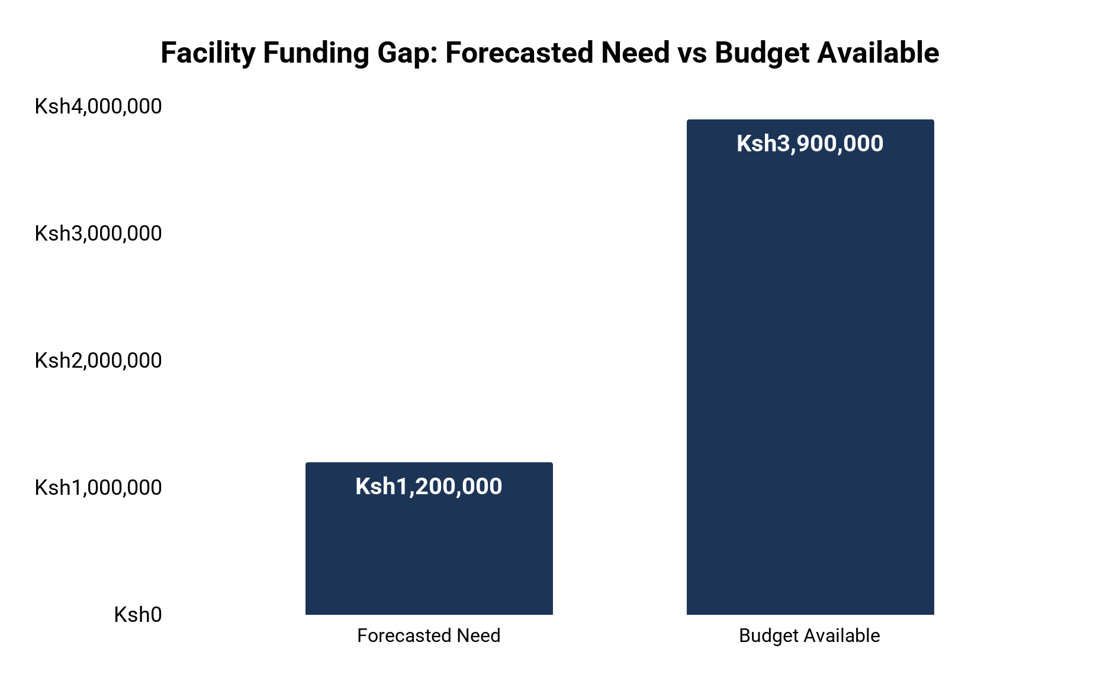
Results: Planning Under Constraint
KES 3.9M
KES 1.2M
69.2%
Forecasted Need
Available Budget
Funding Gap
Prioritized MNCH Commodities | Forecasted Quantity | Prioritized Quantity
Amoxicillin Tablet (dispersible, scored) 250mg | 112 | 112
Chlorhexidine Gel 7.1% (as digluconate) (20 g tube) | 212 | 212
Co-Pack of 4 Sachets of Low Osmolarity ORS (500mL Formulation) + 10 Tabs of Dispersible Zinc Sulphate Tabs 20mg | 1375 | 1375
Gentamicin 40mg/mL (as sulphate) (2mL vial) | 675 | 675
Magnesium sulphate Injection 500mg/mL (50%) (10mL amp/vial) | 30 | 421
Oxytocin 10 Iu/1ml,10 pack | 478 | 478
Tetracycline Eye ointment 1% (as HCl) | 39 | 239
The original forecasts for Magnesium Sulphate (30 units) and Tetracycline Eye Ointment (39 units) implied only 39 deliveries over 3 months - far too low for a newly elevated MNCH facility. Quantities were revised aligning supplies with Tom Mboya's specialized maternal mission.
💡 SMArT provides the scientific floor. Human judgment raises it where the data falls short.

Slide 8
Discussion: What SMArT Delivers
The Tom Mboya Hub SMArT use case creates measurable value at every level of the health system
⚡ Speed
⚖️ Equity
🔍 Transparency
Allocation time reduced from hours to minutes freeing teams to focus on delivery, not paperwork.
Proportional distribution ensures no facility is shortchanged regardless of sub-county politics.
Every allocation decision is documented, auditable and exportable ; accountability built in.
📊 Data-Driven
🧠 Adaptive
🤝 Human+AI
Real-time KHIS data, workload and forecasts replace guesswork with evidence at every step.
Works at any facility level ( Level 2 to Level 5) and adapts when facility context changes.
The tool generates the scientific floor. Clinical teams raise it. Technology and judgment together.

Slide 9
Conclusion: Why This Matters For Kenya
SMArT transforms commodity procurement from a manual exercise into a continuous,
evidence-driven system that learns and adapts, making every shilling count.
🌍 National Scale
💊 Service Continuity
SMArT is built to operate across all 47 counties and across all levels so long as funding is available, delivering consistent, equitable allocation from the coast to the border.
By ensuring critical commodities are always prioritized, SMArT protects service delivery even when budgets are severely constrained.
📋 UHC Alignment
🔄 Continuous Learning
Every allocation decision advances Kenya's Universal Health Coverage agenda by directing limited resources to the highest-impact products.
The tool's audit trail enables counties to review past decisions, learn from deviations, and continually improve their procurement strategies.

Slide 10

Scale SMArT Across Kenya
Adopt SMArT
Integrate with National Systems
Connect your county to SMArT today.
inSupply with DHPT, can onboard the county health management teams to the tool.
inSupply is currently working with DHPT and DHA to make the took interoperable with KEMSA, MEDS and Kenya EMRs.
Contact inSupply Health to begin
DHPT & DHA working to fast-track integration
Train Your Teams
We provide structured training for county, sub-county and facility teams , covering all user roles from allocation to review.
📧 For more information: www.insupplyhealth.com | Ministry of Health through DHPT | #KeHSCon2026
Multi-cadre training available now

Slide 11






Thank you!
Scan to visit our website
#KeHSCon2026
@NPHIKenya
www.nphi.go.ke

